Slide 1
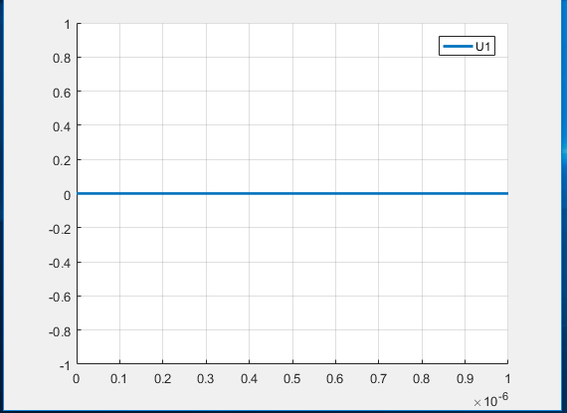
Gate-Source İnput voltage ( off)

Slide 2
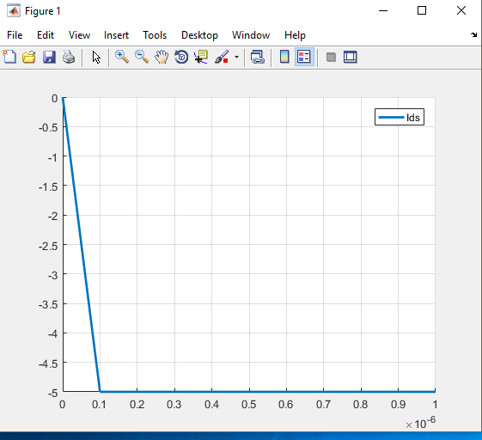
Current Biasing ( Reverse Biased)

Slide 3
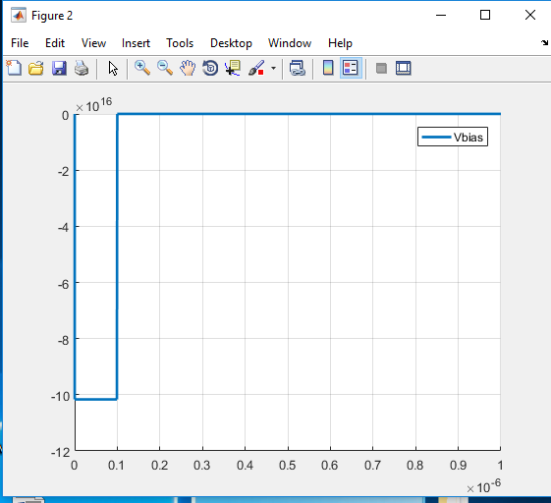
Drain-Source Outpin voltage

Slide 4
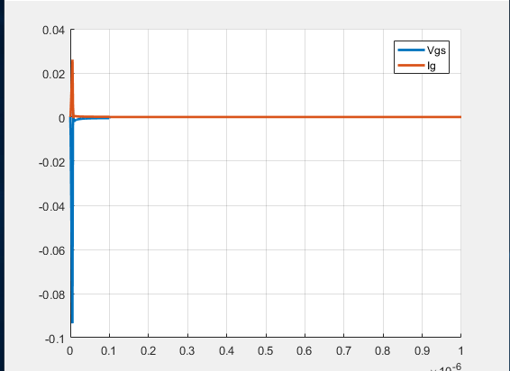
Gate Source inner

Slide 5
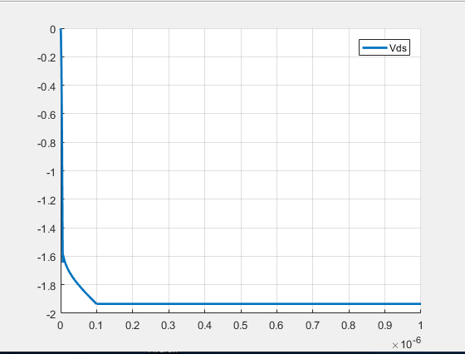
Drain Source inner

Slide 6
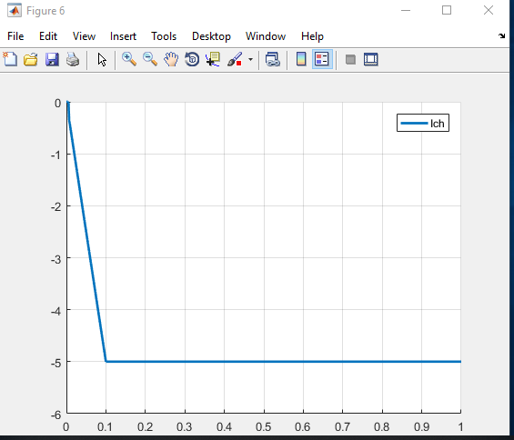
Channel current

